Slide 1

Performance Analysis of Game Engines on mobile and fixed platforms
By: Nicholas Jones

Slide 2
Methodology
Evaluate game on stand alone device and then using cloud server and record GPU and CPU consumption
Build a valued graph of each module which reflects CPU consumption
Compare in terms of CPU and GPU

Slide 3
Technologies Used
AWS
Unreal Engine
Windows
Android
GPU Profiler

Slide 4
Device Specs
Moto G Power 2019
OS- Android 10
CPU- Qualcomm Snapdragon
64 GB
4 GB Ram
HP Notebook AMD Radeon R5 2016
AMD A10 Radeon R5
8GB Ram

Slide 5
Trials of Ascension
3D hack and slash game made on Unreal Engine 4.26
Goal is to Kill NPC monsters
Cross Platform game through use of Cloud server. Also, cross platform. Able to work on android and Windows

Slide 6
Computation Offloading
Not practical for results of standalone version because of how much work the GPU is already doing and considering the age and performance of HP Notebook.
Through further research though the GPU make spike on certain CPU-Bound cases which means the GPU is waiting for the CPU to catch up.
Some computation offloading is done using the AWS Virtual machine as a server.

Slide 7
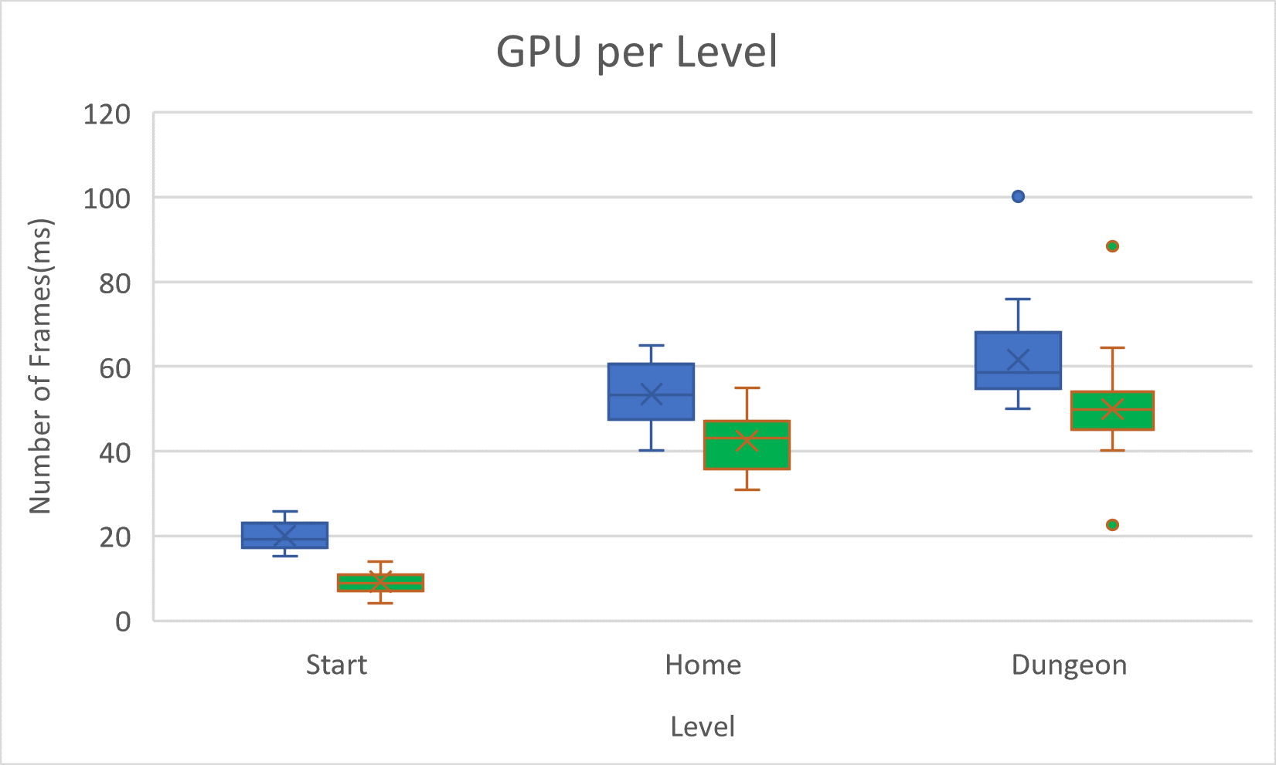
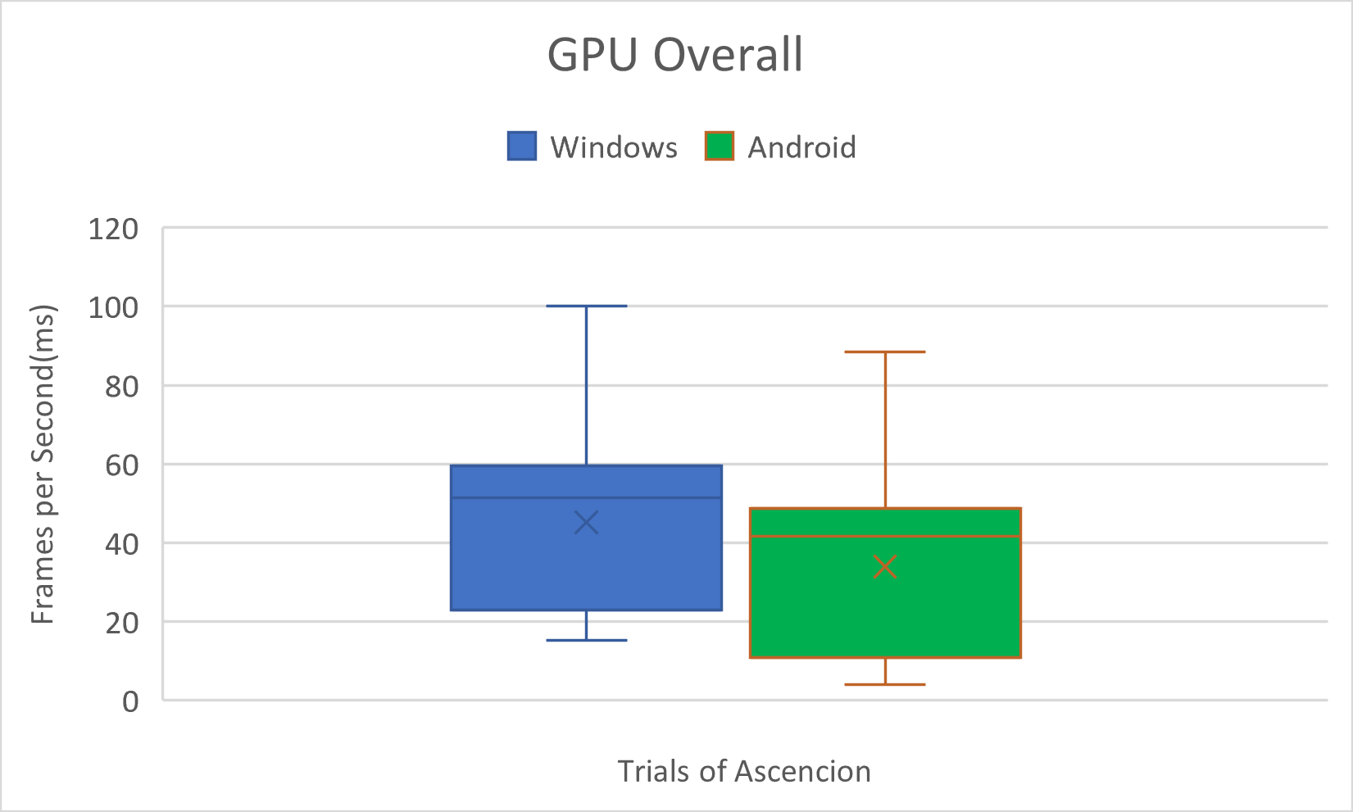
GPU Data- Standalone Version
GPU Performance per Level
GPU Performance Overall

Slide 8
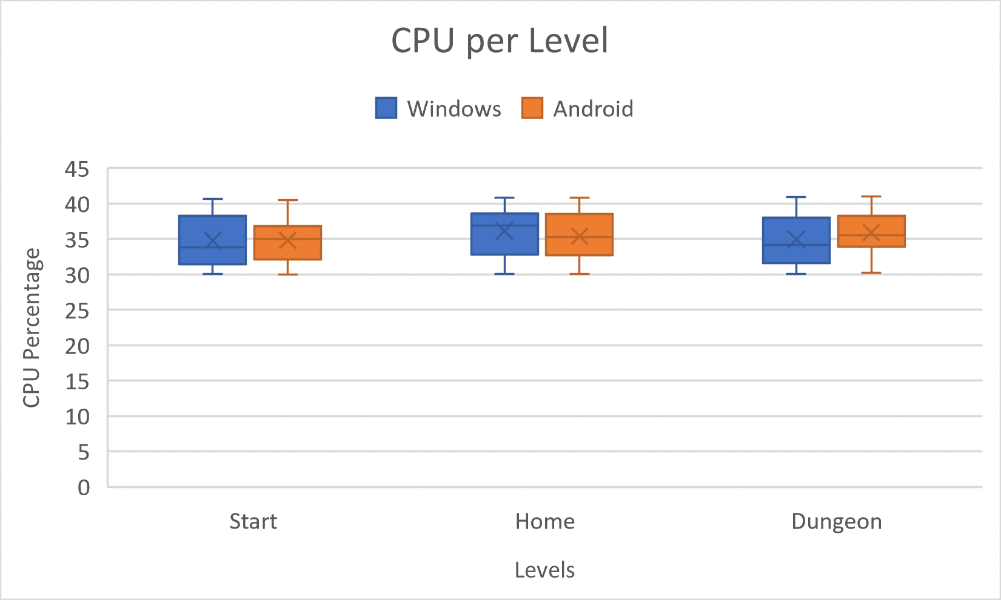
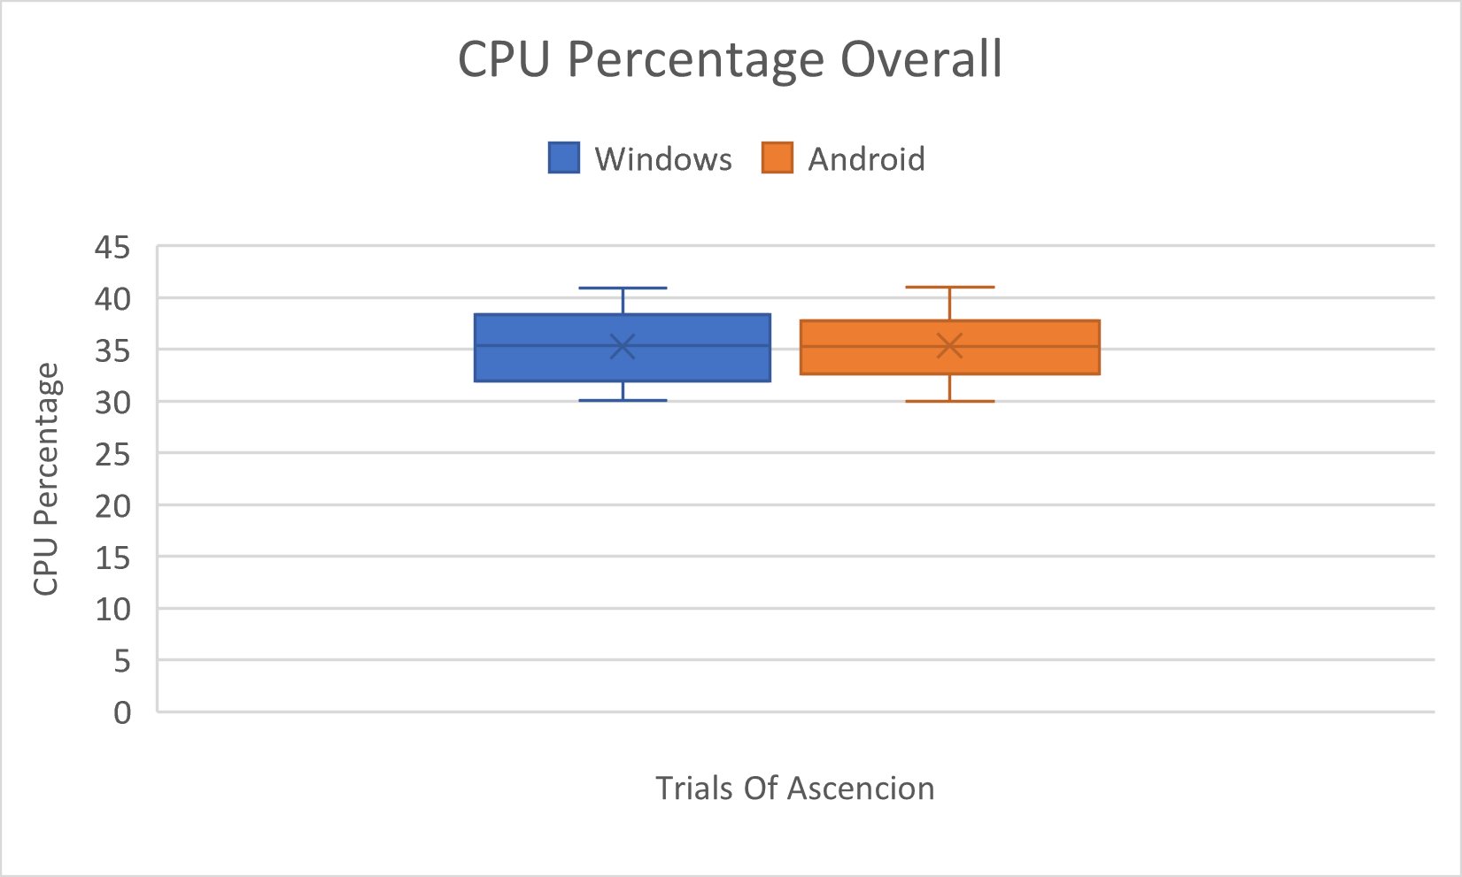
CPU Data-Standalone Version
CPU Performance per Level
CPU Performance Overall

Slide 9
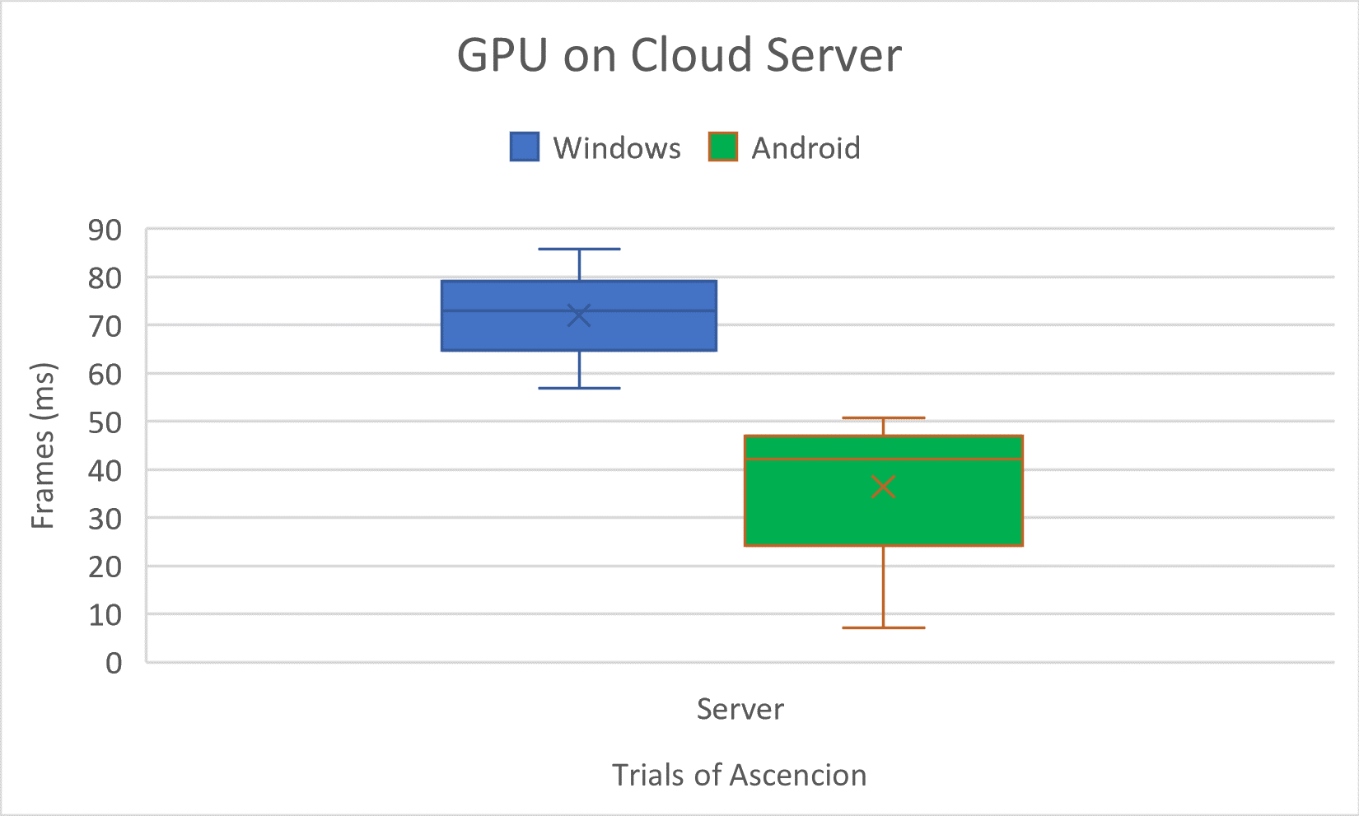
GPU Data- Cloud Server

Slide 10

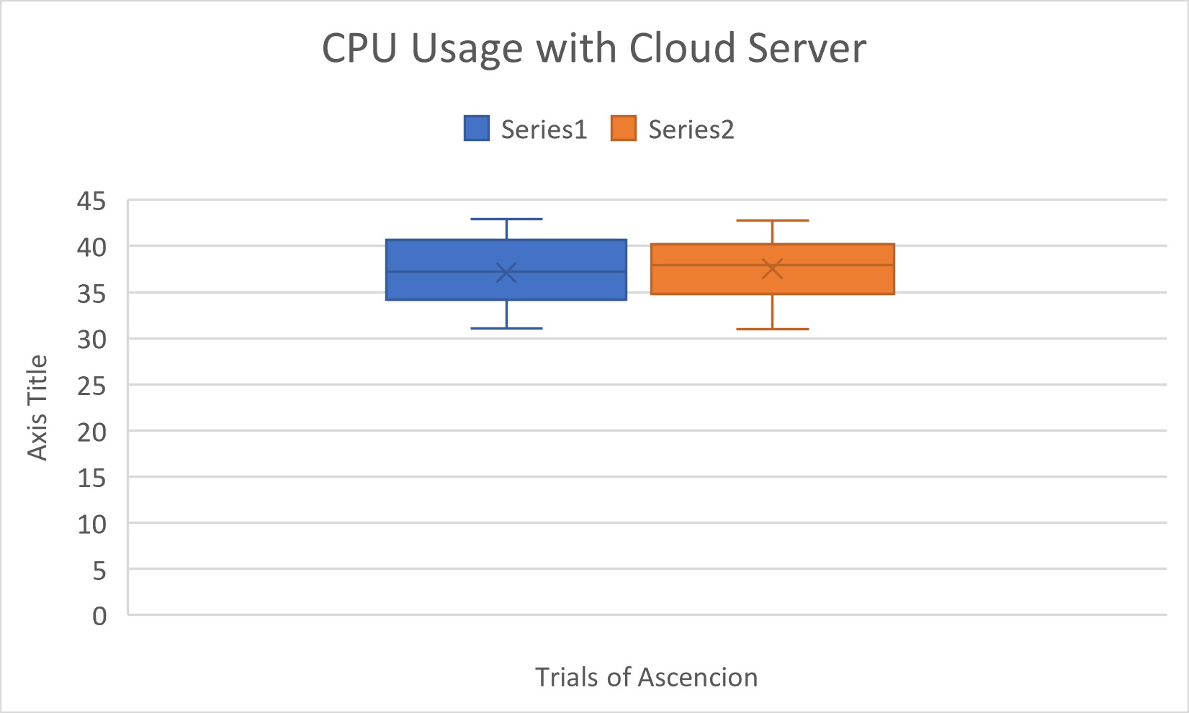
CPU Data- Cloud Server

Slide 11
Performance , Quality, and Platform
The quality matters. Depending on certain settings such as window size this can affect how your game plays. These type of settings are limited to the platform you are using. When regarding the research presented it was hard to make a comparison because of the used platforms. With change in quality on a Windows 10 machine the CPU does increase with change in quality. No such results could be verified for Android since the size is usually fixed to your device.

Slide 12
Playability and Resource Variability
Playability- The game you’re running and its performance matters. Certain types of games with take more CPU calculations and GPU rendering. For the research presented this game was very basic, using simple AI and Not very complex graphics, so it’s playability is rather simple.
Resource Variability – This would be the main impact of the research. The condition of your system affects how your engine and game will perform.

Slide 13
Results
The GPU effects performance the most. This happens based on the number of pixels in the area. In most cases the CPU is waiting for the GPU to catch up. This is where you would usually experience lag. When it came to the GPU, Android seemed to be able to perform better, but with less consistency.
When it comes to CPU performance both Windows and Android have similar stats. This is due to the game not having any very complicated AI, Physics, or scripts to compute. This could also be an issue though because now the devices just have extra resources not being used on the CPU.

Slide 14
Results (cont.)
Most CPU consumption is determined by AI, physics, and scripts. With this taken into consideration combined with the idea of computation offloading, offloading simple CPU task could free CPU up for more complex computations.
When considering performance analysis of a game engine, a lot of the performance does come down to resource variability and game playability.

Slide 15
Further Expansion
Make own personal game engine with computation offloading in mind and develop a partitioning algorithm, so that the game engine knows when and what computations to offload off the CPU.
If I was able to do this project again, I’d try to do it with more up to date hardware which would enhance the resource variability.

Slide 16
References
Messaoudi, Farouk, et al. “Performance Analysis of Game Engines on Mobile and Fixed Devices.” ACM Transactions on Multimedia Computing, Communications, and Applications, vol. 13, no. 4, 2017, pp. 1–28. Crossref, doi:10.1145/3115934.
The main way I set up my enemy AI was by following an 8-part series I found on YouTube. It taught me how to use Behavior Trees, Blackboards, Set up my AI controller, and use animations and montages. https://youtube.com/playlist?list=PL4G2bSPE_8ulvuPbPGC7rThydK5pBdB9G
The next video tutorial I used taught me how to make a portal to move between levels by making a level trigger and adding a particle effect to it. https://youtu.be/bbmg73De03g

Slide 17
Assets Used
Paragon: Greystone
● Used as player character
● Downloaded for free from the Epic Games Market Place
● https://www.unrealengine.com/marketplace/en-US/product/paragon-greystone
Paragon: Grux
● Used as enemy AI
● Downloaded for free from the Epic Games Market Place
● https://www.unrealengine.com/marketplace/en-US/product/paragon-grux
Nordic Forest
● Used to craft environment for first level
● Downloaded for free from Unreal Engine Market Place
● https://www.unrealengine.com/marketplace/en-US/product/ed6646c7e7344f2ca9fdaa62 1b10dd39/reviews References and Tutoria

Slide 18
Assets Used (cont.)
Infernity Blade Grass Land
Used for Server and Home Environment
Downloaded from Epic Games Market
https://www.unrealengine.com/marketplace/infinity-blade-plain-lands
Nordic Forest
● Used to craft environment for first level
● Downloaded for free from Unreal Engine Market Place
● https://www.unrealengine.com/marketplace/en-US/product/ed6646c7e7344f2ca9fdaa62 1b10dd39/reviews References and Tutoria

